Slide 1


Workshop Practice-Electrical [MME 1061]
. Electrical Wiring Practice-I & II

Slide 2
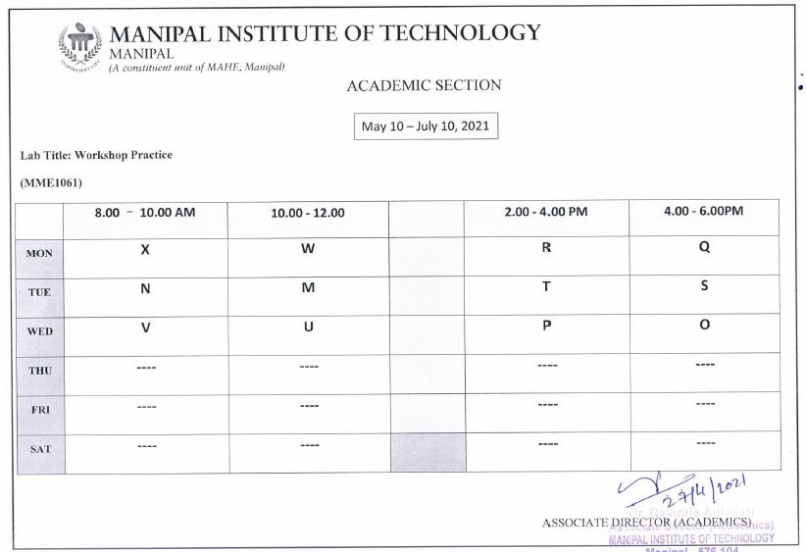

Slide 3
Conducting labs on rotation

Slide 4
SAFETY PRECAUTIONS FOR E&E MODULES
Wearing a pair of shoes is MANDATORY.
All the wiring connections should be firm & tight. No loose connections in circuits. No joints to be made between cables in open.
Students are required to get their wiring connections checked by the Staff on duty before powering the mains supply ON.
NEVER touch the electrically energized (“LIVE”) portions of the circuits when the experimental conduction is ongoing.
At the end of every conduction, mains MCB must be turned off. Any additions / modifications in the electrical circuits should be done only after this is ensured.
Keep away from the rotating shaft of the motor.
Do not touch a soldering iron (after powering it on) to avoid burns injury. When it is not in use, place it always in its stand.
Avoid accidental burning of the insulation of the soldering iron’s power cord by plugging it to a power socket away from its stand.

Slide 5
ELECTRICAL WIRING PRACTICE-I
Objective:
To familiarize with the components and wiring of single-phase domestic appliances.
To estimate electrical energy charges.
Components Required:
1 Way Switches, Holder for Incandescent Lamp, Incandescent Lamp, Fan, Regulator, 3-pin Socket, 2-Way Switches, Cables.
Precautions:
Power to the Experimental table must be OFF before making connections.
Ensure that the cables are terminated properly.
Do not to touch the terminals when the power is ON.

Slide 6
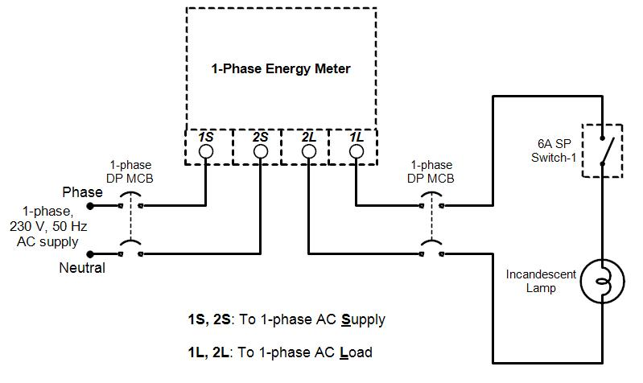
Exercise-1
Problem Statement:
To develop a single-phase wiring scheme to power loads consisting of an incandescent lamp, a Fan and a 3-pin Socket.
Step-1: Wiring of the Lamp Circuit:

Slide 7
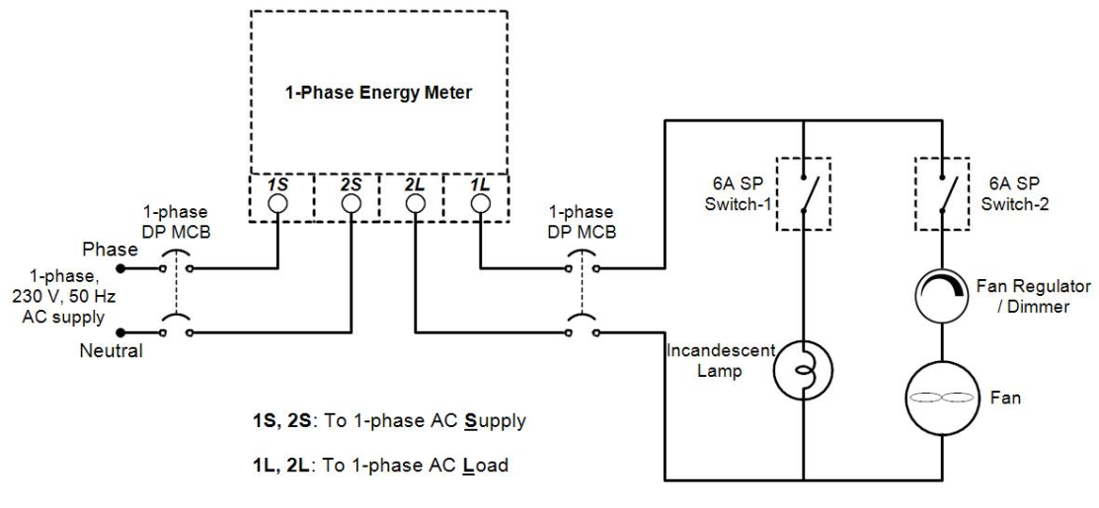
Step-2: Connecting the Fan with the Regulator:

Slide 8
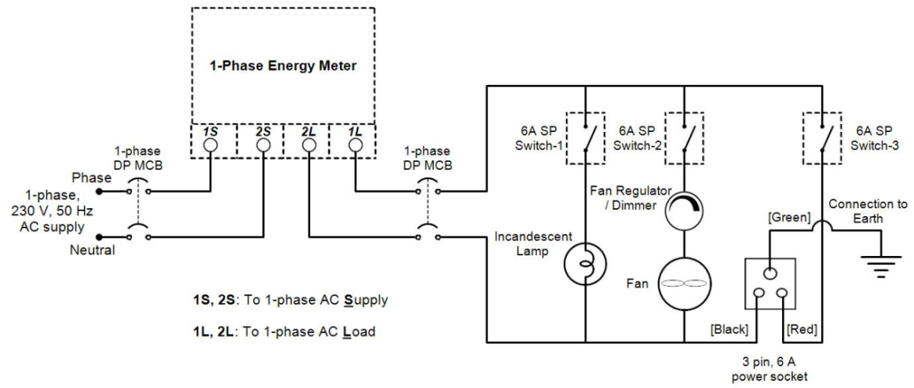
Step-3: Connecting the 3-pin Socket:

Slide 9
Procedure:
Develop the connections step-by-step as shown above.
Get the circuit checked by the Instructor.
Power ON the supply and verify the functionality of the wiring scheme.
Switch OFF the supply.
Estimate the energy consumption for 30 minutes with the above loads.
Observations:
Estimated energy consumption for 30 minutes = Total energy consumed by all loads* (30/60) kWh.

Slide 10
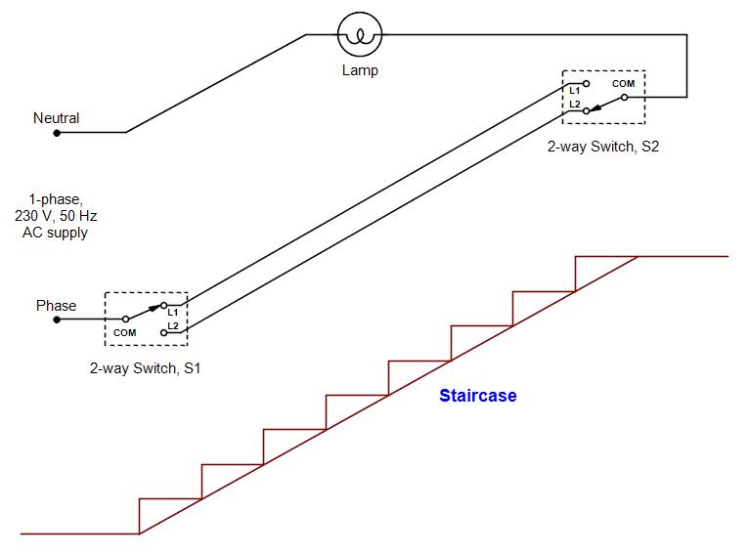
Problem Statement:
To develop a single-phase wiring scheme to control a Lamp by 2 two-way Switches (Staircase wiring).
Wiring of 2-way control of a lamp: Layout Diagram

Slide 11
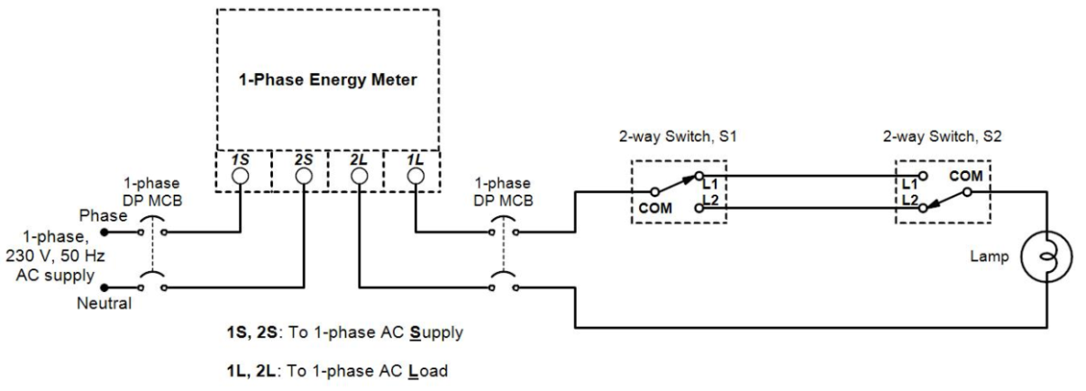
Wiring of 2-way control of a Lamp: Circuit Diagram:
Procedure: Make the connections as shown above and verify the functionality.

Slide 12
Case Study on Estimation of Cost of Energy:
A bath attached room is fitted with two Fluorescent lamps (36 W each), LED Lamp (9 W), Fan (70 W), Electric Iron (1 kW), Geyser (2 kW), Air Conditioning unit (1.6 kW). Determine the monthly energy charges for the following daily load pattern.
Fluorescent lamps are switched ON from 5 AM to 7:30 AM & 6 PM to 10:30 PM; LED lamp from 6 PM to 8 AM; AC from 6 PM to 7 AM (Assume a duty cycle of 60 % for AC). Fan is used for 4 hours; Electric Iron and Geyser are used for one hour each.
Refer to Electricity Tariff, LT 2(a)(i) given in Annexure-1 and determine the energy charges for the electricity consumed.
Calculations:

Slide 13
ANNEXURE-1
Electricity Tariff LT 2(a)(i) of Mangalore Electricity Supply Company Limited (MESCOM):
Rate Schedule of MESCOM’s LT-2(a)(i) Retail Electricity Supply Tariff [as per the order of Karnataka Electricity Regulatory Commission (KERC)] effective from 30 May 2019 is as given below
Fixed Charges per month:
Energy Charges:
For the first kW | Rs. 60/- per kW
For every additional kW | Rs. 70/- per kW
For 0 - 30 units (i.e., first 30 units) | Rs. 3.70/- per unit
31 to 100 units (for next 70 units) | Rs. 5.20/- per unit
101 to 200 units (for next 100 units) | Rs. 6.75/- per unit
Above 200 units | Rs. 7.80/- per unit

Slide 14
Solution:
S.No. | Type of Load | Number | Power Rating (W) | Working Hours | Energy Consumption (Wh)
1 | Fluorescent lamps | 2 | 36*2=72 | 7 | 504
2 | LED Lamp | 1 | 9 | 14 | 126
3 | Fan | 1 | 70 | 4 | 280
4 | Electric Iron | 1 | 1000 | 1 | 1000
5 | Geyser | 1 | 2000 | 1 | 2000
6 | Air Conditioning unit | 1 | 1600 | 13*0.6=7.8 | 12480
Total Energy Consumption (kWh) |  |  |  |  | 16.39
Total Power Rating of the Loads =4.751 kW
Total Energy Consumption Per Month= 16.39*30=491.7 units

Slide 15
Contd.
Fixed Charges Per Month= 60+ (3.751*70)= 322.57 Rs.
Energy Charges: per month for 491.7 Units of Energy consumption
For 0 - 30 units (i.e., first 30 units) | Rs. 3.70/- per unit | 30*3.70=111 Rs.
31 to 100 units (for next 70 units) | Rs. 5.20/- per unit | 70*5.2= 364 Rs.
101 to 200 units (for next 100 units) | Rs. 6.75/- per unit | 100*6.75= 675 Rs.
Above 200 units | Rs. 7.80/- per unit | 291.7*7.8= 2275.26 Rs.
Total Energy Charges per Month: 3425.26 Rs.
Total Electricity Bill to be Paid per month: Fixed Charges+ Energy Charges
: 322.57+3425.26= 3747.83 Rs.
Notes:
‘Huges Electrical & Electronic Technology’, 10th edition
Page No. 303, Example 14.1

Slide 16
ELECTRICAL WIRING PRACTICE-II
Objective:
To familiarize with the components and wiring of three-phase circuits.
To estimate the electrical energy charges for three-phase loads.
Components Required:
1-way Switches, Holders for Incandescent Lamps, Incandescent Lamps, Three-phase Fractional HP (0.25 HP/0.18 kW) Induction motor, DOL Starter, Cables.
Precautions:
Power to the Experimental table must be OFF before making connections.
Ensure that the cables are terminated properly.
Do not to touch the terminals when the power is ON.
Notes:
‘Huges Electrical & Electronic Technology’, 10th edition
Page No. 303, Example 14.1

Slide 17
Problem Statement:
To develop a three-phase wiring scheme to power single-phase loads consisting of incandescent lamps in three phases and a three-phase load (i.e., a 3-phase Induction Motor).
Procedure:
Develop the connections step-by-step; first for ‘R’ phase and then for ‘Y’ and ‘B’ phases as shown in the circuit diagram overleaf.
Get the circuit checked by the Instructor.
Power ON the supply and verify the functionality of the wiring scheme.
Switch OFF the supply.
Notes:
‘Huges Electrical & Electronic Technology’, 10th edition
Page No. 303, Example 14.1

Slide 18
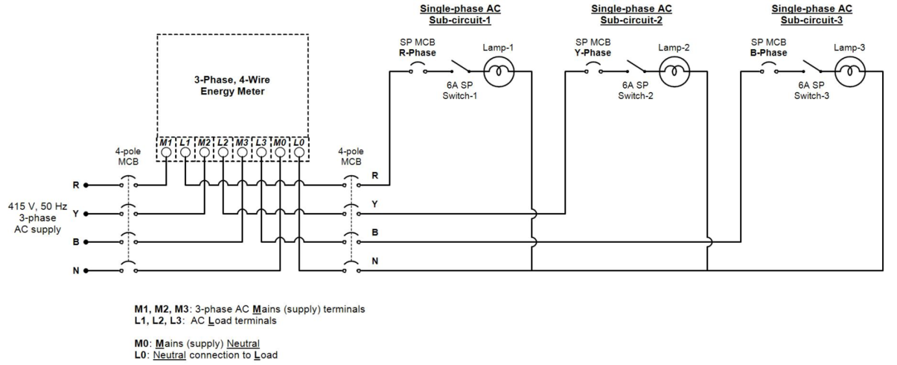
Step-1: Wiring of Lamp Loads in three phases:
Notes:
‘Huges Electrical & Electronic Technology’, 10th edition
Page No. 303, Example 14.1

Slide 19
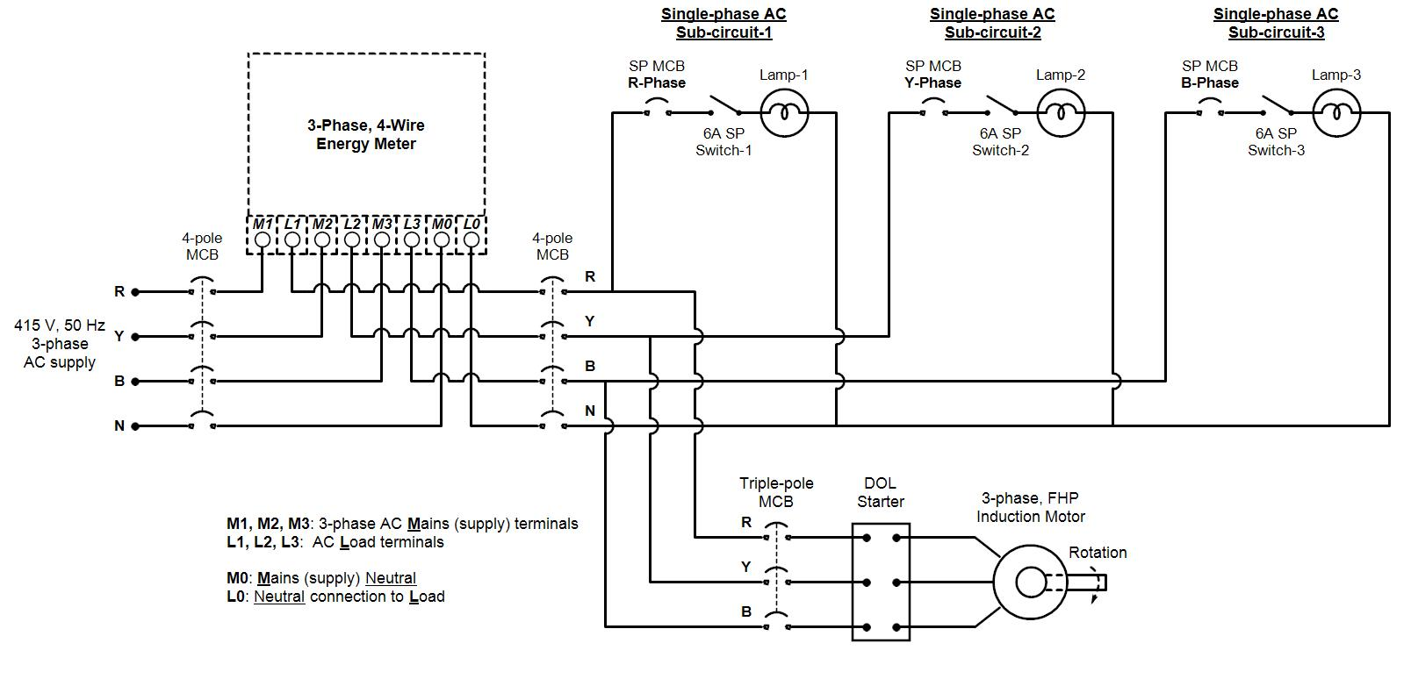
Step-2: Connecting the Three-Phase Induction Motor:
Write down the name-plate details (Ratings) of the 3-phase induction motor below.
Notes:
‘Huges Electrical & Electronic Technology’, 10th edition
Page No. 303, Example 14.1

Slide 20
Procedure:
Make the 3-phase Induction Motor connections additionally as shown overleaf.
Get the circuit checked by the Instructor.
Power ON the supply to the circuit.
Press the START (Green) button on the Direct On-Line (DOL) starter.
Measure the no-load speed by using a tachometer.
Observe the direction of rotation.
Also, switch ON all the lamps.
STOP the three-phase induction motor by pressing STOP (Red) button on DOL starter.
Switch OFF the power supply.
Interchange any two supply line cables (out of the three) in the motor circuit.
Follow steps 3 – 6. Observe that the direction of rotation of the motor is reversed.
STOP the motor and switch OFF the supply.
Estimate the energy consumption of the circuit for 30 minutes.
Notes:
‘Huges Electrical & Electronic Technology’, 10th edition
Page No. 303, Example 14.1

Slide 21
Observations:
RMS value of 3 line voltages (Line to Line values):
V_{RY} = V_{YB} = V_{BR} =
RMS value of 3 Phase voltages (Line to Neutral values):
V_{RN} = V_{YN} = V_{BN} =
Frequency (Hz): f =
Measured no-load speed (rpm): N =
Estimated energy consumption for 30 minutes = kWh
Notes:
‘Huges Electrical & Electronic Technology’, 10th edition
Page No. 303, Example 14.1

Slide 22
Workshop Practice-Electrical [MME 1061]
INTRODUCTION TO ELECTRICAL LIGHTING SOURCES

Slide 23
Objective:
To compare Natural Lighting with Artificial Lighting and also to
familiarize with various electrical lighting sources.

Slide 24
Types of Lighting
Natural Lighting:
Daylight is the light received from Sun. However, the illuminance (i.e., the amount of light reaching earth’s surface, measured in terms of lux) can vary from 1,00,000 lux for direct sunlight at noon in summer, to less than 5 lux for thick storm clouds with the sun at the horizon.
Artificial Lighting:
Artificial Lighting is illuminating the facility or environment using electrical light sources. An illuminance level of 300 lux to 500 lux is expected for office lighting and classroom lighting.

Slide 25
Definitions
Luminous Flux: It is the electromagnetic radiant energy which is human eye sensible, radiated per second in all possible directions by a luminous body. Its unit is lumen (lm). Example: Luminous flux output of an incandescent lamp of 100 W is 1,200 lm to 1,300 lm
Luminous Efficacy: Energy efficiency of a light source is measured in terms of luminous efficacy. It is the ratio of lumen output per watt of input electrical power; of a light source. Its unit is lumen/watt.
Average illuminance: It is the amount of light reaching the unit surface area. Its unit is lm/m² (Lux).
Colour Temperature: Colour temperature of a source is a temperature at which a Black Body Radiator must be operated in order to emit radiation evoking colour sensation exactly the same as that produced by radiant energy from the source in question. Unit is kelvin (K).

Slide 26
Definitions:
5. Colour Rendering Index (Ra): Colour appearance of a source depends on spectral energy distribution of the light emitted by it. It is a measure of light source capability of faithful surface colour reproduction. True colour recognition is possible on by black body sources. Ideal Light Source is the Sun or an Incandescent lamp. CRI requirements differ by lighting application.
CRI 90 - 100: Retail (merchandise, artwork) and work spaces (design) where faithful colour rendering is critical.
CRI 70 - 90: Most office, retail, school, educational, medical, and other work and residential spaces.
CRI as low as 50: Industrial, security and storage lighting where colour fidelity is not important

Slide 27
Definitions:
6. Incandescence: Certain bodies when heated to high temperature start producing light in visible range in continuous spectrum. The phenomenon of emitting radiation is called incandescence. Examples: Red hot coal stove – red colour radiation - 800K, Burning candle – 2,000K, Tungsten filament bulb – 2,800K, Halogen bulb – whitish yellow – 3,000K, Sun at noon with clear sky - white light – 5,500K
7. Luminescence: This is opposite of incandescence. The emission of light as a result of the excitation of atoms by energy other than heat. The emission of light that does not derive energy from the temperature of the emitting body. They are caused by chemical reactions, electrical energy, sub-atomic motions or stress on a crystal.

Slide 28
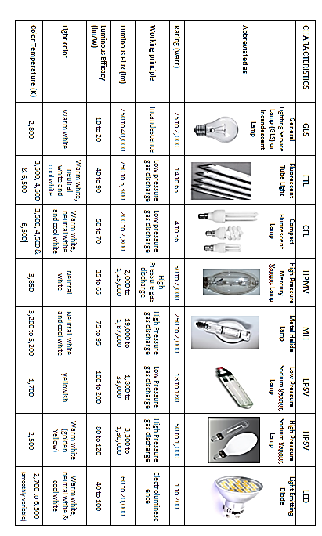
Performance characteristics of different electrical light sources

Slide 29
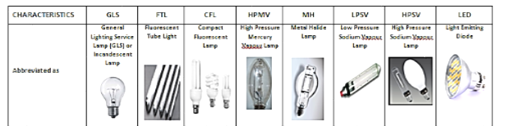
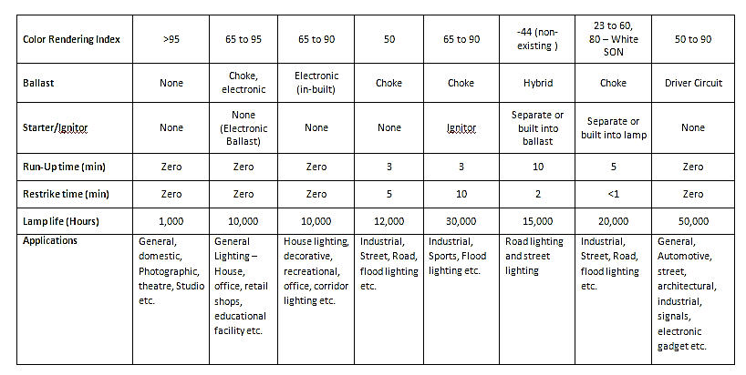

Slide 30
THANK YOU

